Slide 1
Team: Bug Slayer
Gaurab Aryal
Rupak Karki
Santosh Kumar Shah
Salim Shrestha
EventHub
College Event Management System

Slide 2
Agenda
Introduction
Problem Statement
Solution Overview
Key Features
Technology Stack
System Architecture
Database Design
Workflows
Future Enhancements
Conclusion

Slide 3
Introduction
Event management is an essential part of colleges and organizations.
However, many events are still managed manually, which can be inefficient and difficult to handle.

Slide 4
Problem Statement
Manual registration → long queues, data loss
No centralised event listing
Difficult attendance tracking
Poor communication
Lack of analytics
Lack of real-time updates

Slide 5
Solution Overview
Provide a centralized platform for event management
Enable students to discover and register for events easily
Give administrators tools to create and manage events
Track registrations in real-time
Provide analytics and insights on event participation

Slide 6
Key Features
Students: Browse, register, manage profile
Admins: Create events, manage registrations
Venue management
Search

Slide 7
Technology Stack
Frontend: HTML, CSS , JS
Backend: PHP
Database: MySQL
Server: Apache
Authentication: Session-based

Slide 8
System Architecture
Browser → Frontend → PHP API → Database
CRUD operations
Structured backend modules

Slide 9
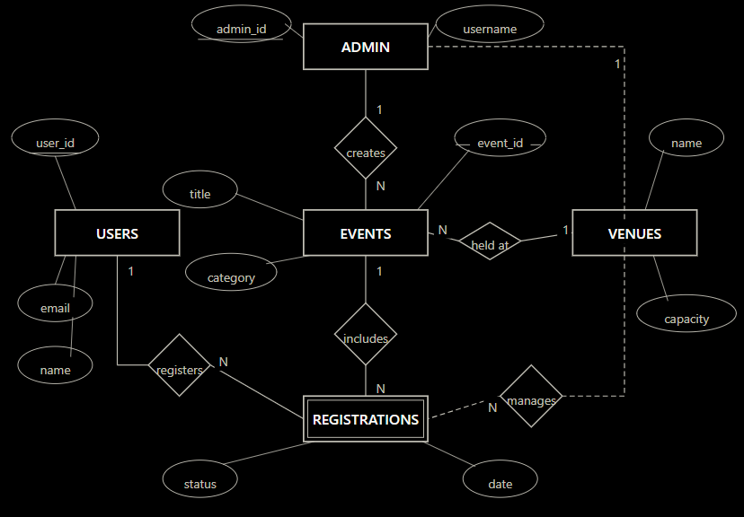

Slide 10
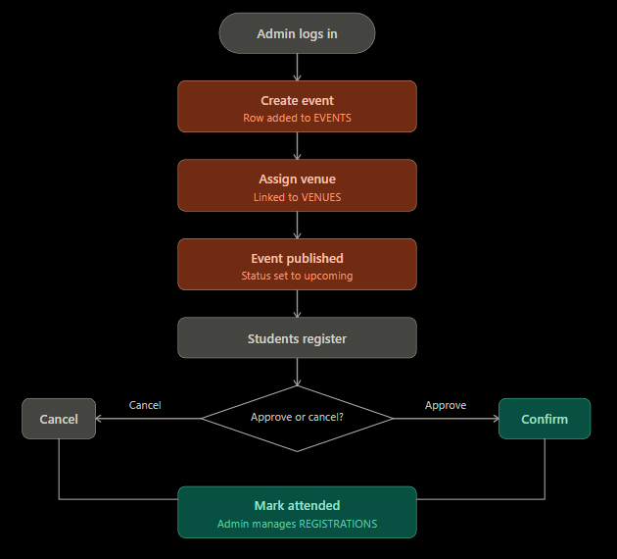

Slide 11
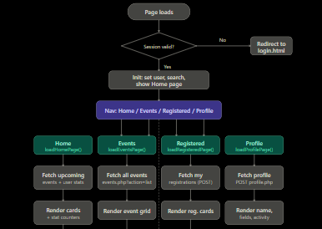
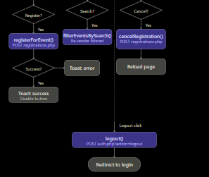

Slide 12
Database Design
Tables: users, admin, events, venues, registrations
One-to-many relationships
Efficient data linking
Scalable structure
12

Slide 13
Student Workflow
Login / Signup
Browse events
Register
View My Events
Cancel / Update profile

Slide 14
Admin Workflow
Login
Dashboard overview
Manage events
Manage registrations
Manage venues

Slide 15
Future Enhancements
Email notifications
Calendar integration
Event scheduling
Mobile app
Advanced analytics

Slide 16
Conclusions
EventHub transforms college events from chaotic to coordinated with centralized tools, real-time engagement, and data-driven insights.

Slide 17
Thanks!
Any questions ?

